Slide 1
Regression
WQD7006
Machine Learning
Vimala Balakrishnan

Slide 2
Regression
Regression is a method of modelling a target value based on independent predictors.
Mostly used for forecasting and finding out cause and effect relationship between variables.
Logistic regression (classification) versus linear regression (predict/forecast)
Classification - seeks to identify the categorical class C associated with a given input vector x.
Regression - seeks to identify (or estimate) a continuous variable y associated with a given input vector x.

Slide 3
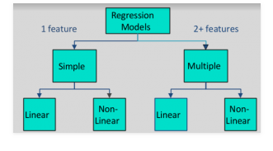
Regression

Slide 4
Checkpoint
Which of the following is a regression task?
Predicting age of a person
Predicting nationality of a person
Predicting whether stock price of a company will increase tomorrow
Predicting whether a document is related to sighting of UFOs?

Slide 5
Checkpoint
Which of the following is/are classification problem(s)?
Predicting the gender of a person by his/her handwriting style
Predicting house price based on area
Predicting whether monsoon will be normal next year
Predict the number of copies a music album will be sold next month

Slide 6
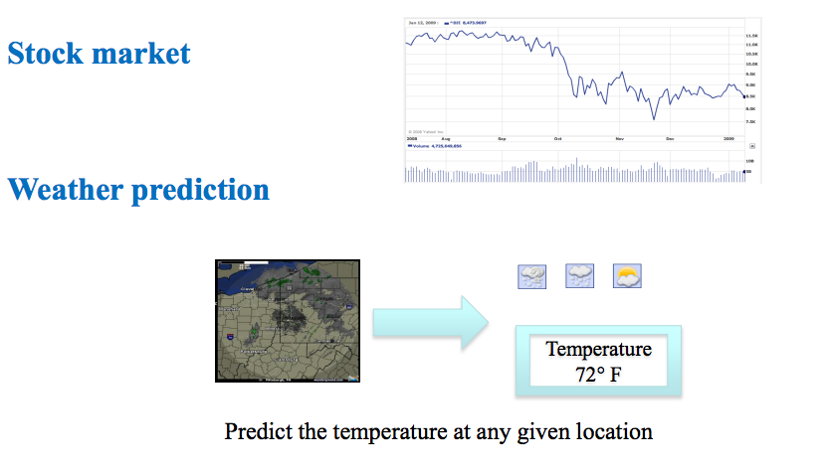
Regression examples
Linear regression

Slide 7
Linear regression
Given an input x we would like to compute an output y
For example:
- Predict height from age
- Predict Google’s price from Yahoo’s price
- Predict distance from wall from sensors
Y
X

Slide 8
Simple Linear regression
Assume that y and x are related with the following equation:
y = wx+ε
where w is a parameter and ε represents measurement or other noise
Y
Dependent
What we are trying to predict
Independent
Observed values
X
Assume starting at 0

Slide 9
Bias coefficient/intercept
Y
y = w₀ + w₁x+ε
Can use least squares to determine w₀ , w₁
w₀
X

Slide 10
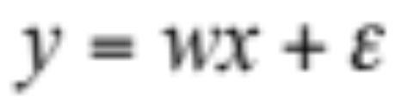
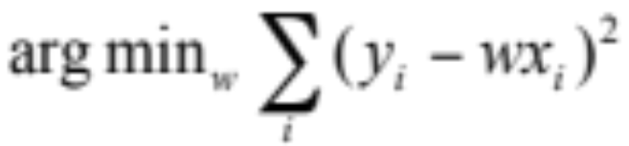
Linear regression
Our goal is to estimate w from a training data of <x_{i},y_{i}> pairs
Optimization goal: minimize squared error (least squares):
Least squares -
- minimizes squared distance between measurements and predicted line
Y
X

Slide 11
Girls Love Fearlessly

Slide 12
Linear Regression
Three steps:
Guess – hypothesis, h(x) or (y = w₀ + w₁x₁+ … + w_{k}x_{k})
2. Calculate cost function (Loss) – “how wrong our randomly selected weights are” – Least Square
3. Fix mistake – optimization (Gradient Descent)

Slide 13

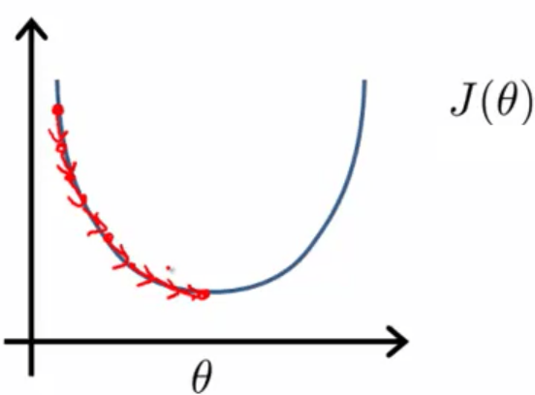

Cost Function
Sum of squared error over all training samples
… and minimize it:

Slide 14
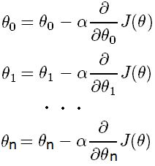
Fixing
Update each slope parameter until loss function = minimum
Alpha
Learning rate
Derivative
Direction of moving
Simultaneously

Slide 15
Multiple linear regression
What if we have several inputs?
- Stock prices for Yahoo, Microsoft and Ebay for the Google prediction task
y = w₀ + w₁x₁+ … + w_{k}x_{k} + ε
Microsoft’s stock price
stock price
Yahoo’s stock price

Slide 16
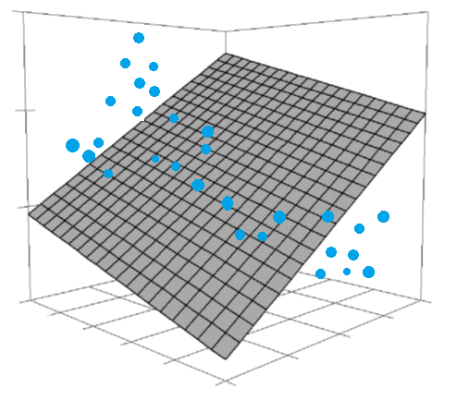
MLR - Guessing

Slide 17
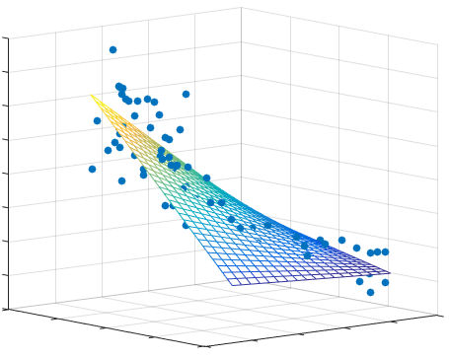
MLR - Fitted

Slide 18
y=10+3x₁-2x₂²+ε
Think
In some cases we would like to use polynomial or other terms based on the input data, are these still linear regression problems?
Yes. As long as the coefficients are linear the equation is still a linear regression problem!
Eg. Polynomial, Gaussian, Sigmoid
Not all functions can be approximated by a line/hyperplane…
Notes:
Add function and best linear approximation

Slide 19
Learning/Optimizing
Gradient Descent

Slide 20
Gradient descent
A process of optimizing the values of the coefficients by iteratively minimizing the error (cost function) of the model on the training data.
Start with random values for each coefficient, and iteratively change the values to reduce error/cost – GD
The sum of the squared errors are calculated for each pair of input and output values. A learning rate (alpha - selected) is used as a scale factor and the coefficients are updated in the direction towards minimizing the error/cost.
The process is repeated until a minimum sum squared error is achieved or no further improvement is possible

Slide 21
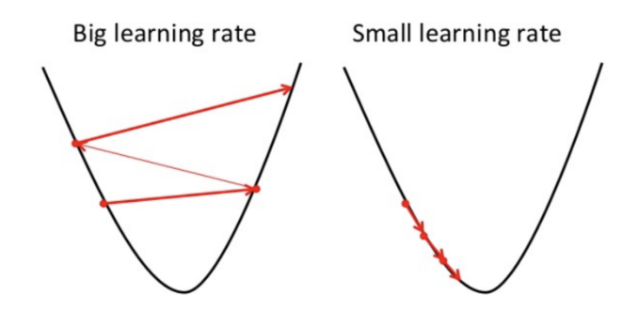
Gradient descent
Slower convergence
Close to minima
Converge sooner
Overshoot minima

Slide 22
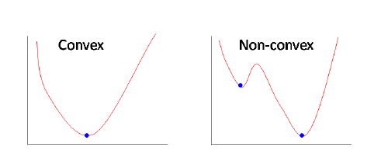
Gradient descent
Linear regression
Gradient descent will reach a global optimum

Slide 23
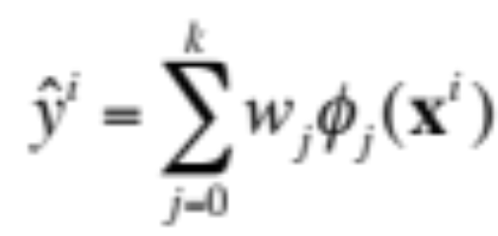
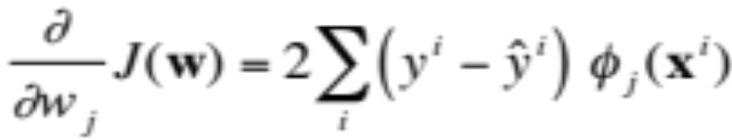
Gradient Descent for Linear Regression
Learning algorithm:
Initialize weights w=0
For t=1,… until convergence:
  Predict for each example x^{i} using w:
  Compute gradient of loss:
  This is a vector g
  Update: w = w – λg
  λ is the learning rate.

Slide 24
Regression and Overfitting

Slide 25
Regularization
These seek to both minimize the sum of the squared error of the model on the training data (using ordinary least squares) but also to reduce the complexity of the model (like the number or absolute size of the sum of all coefficients in the model).
Two popular examples of regularization procedures for linear regression are:
Lasso Regression: where Ordinary Least Squares is modified to also minimize the absolute sum of the coefficients (called L1 regularization).
Ridge Regression: where Ordinary Least Squares is modified to also minimize the squared absolute sum of the coefficients (called L2 regularization).
These methods are effective to use when there is collinearity in your input values and ordinary least squares would overfit the training data.

Slide 26
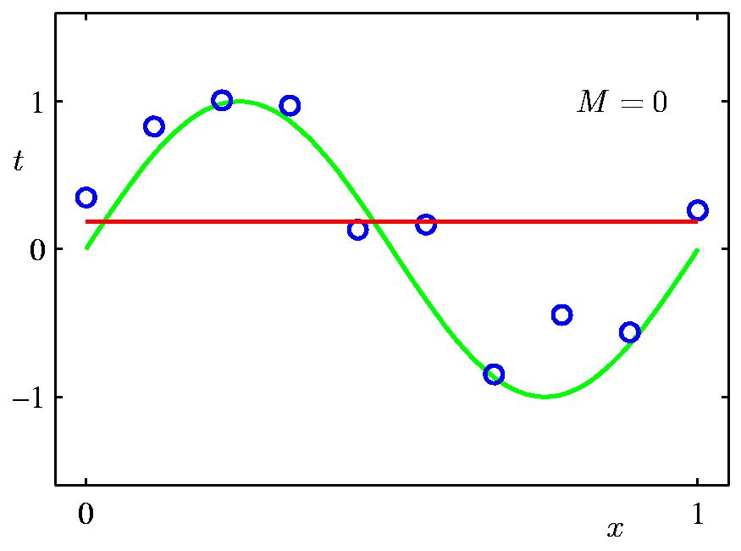
0th Order Polynomial
An example: polynomial basis vectors on a small dataset
n=10

Slide 27
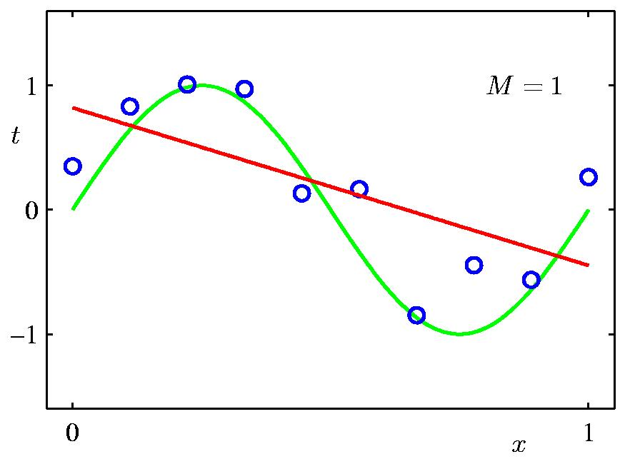
1st Order Polynomial

Slide 28
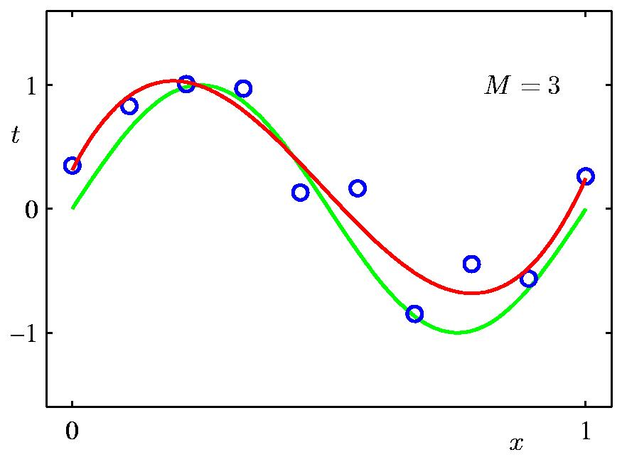
3rd Order Polynomial

Slide 29
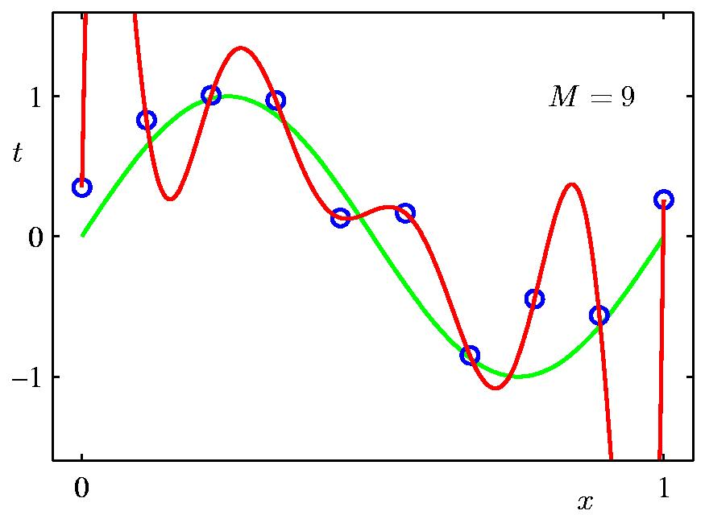
9th Order Polynomial

Slide 30
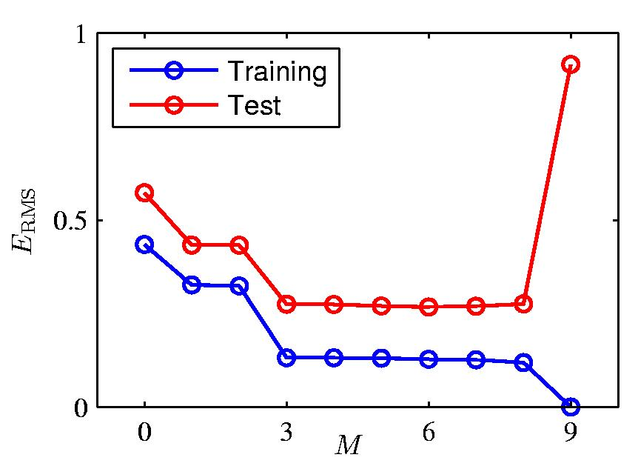
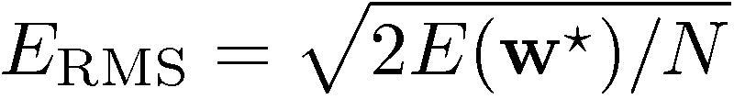
Over-fitting
Root-Mean-Square (RMS) Error:

Slide 31
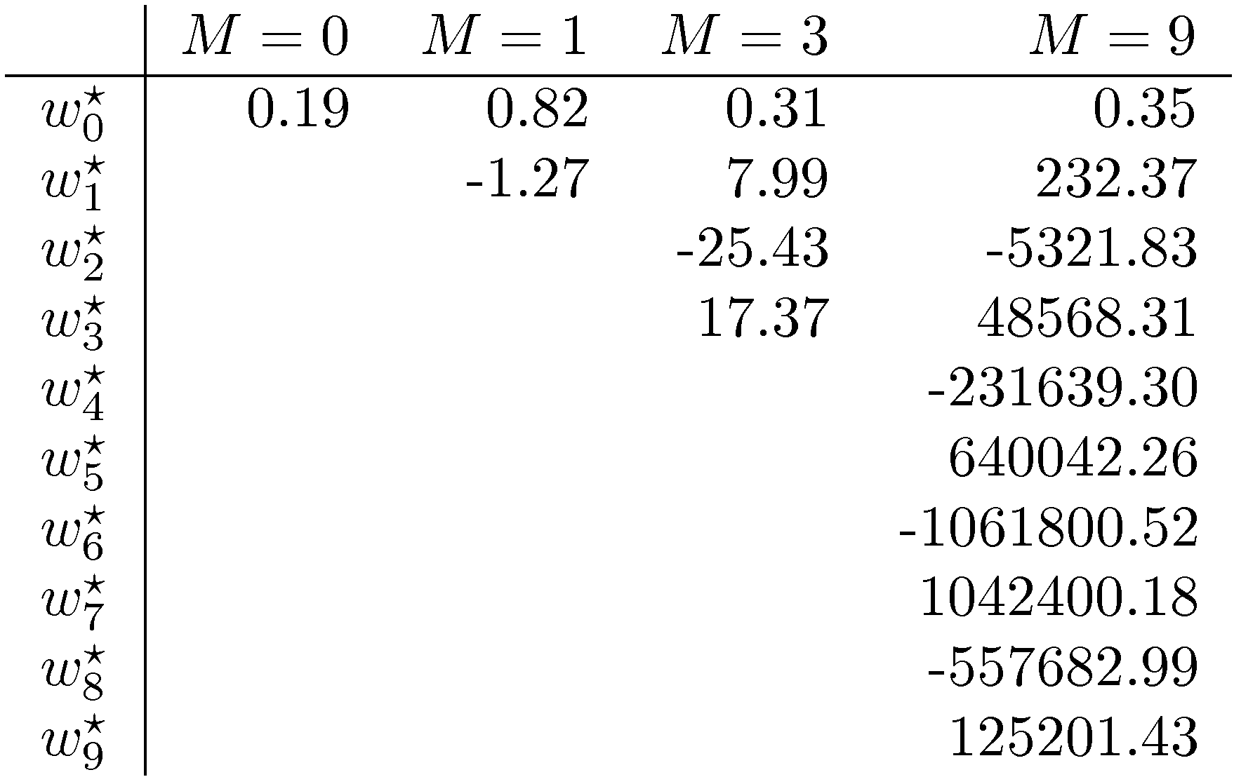
Polynomial Coefficients

Slide 32
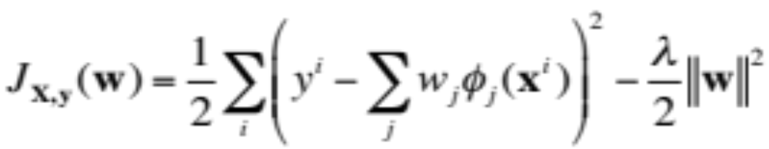
Regularization
Penalize large coefficient values

Slide 33

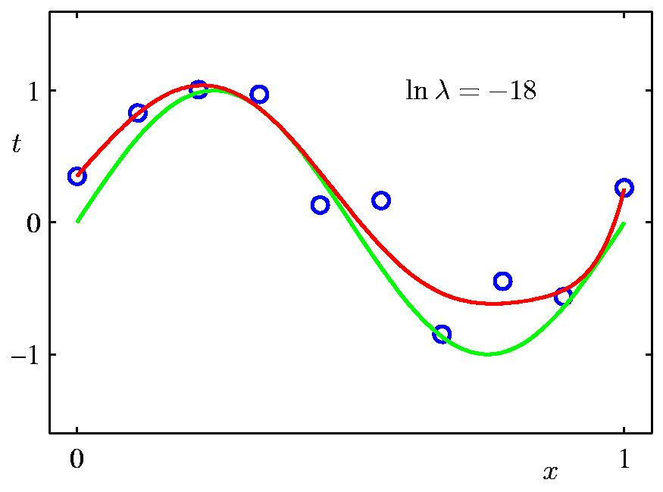
Regularization:
+

Slide 34
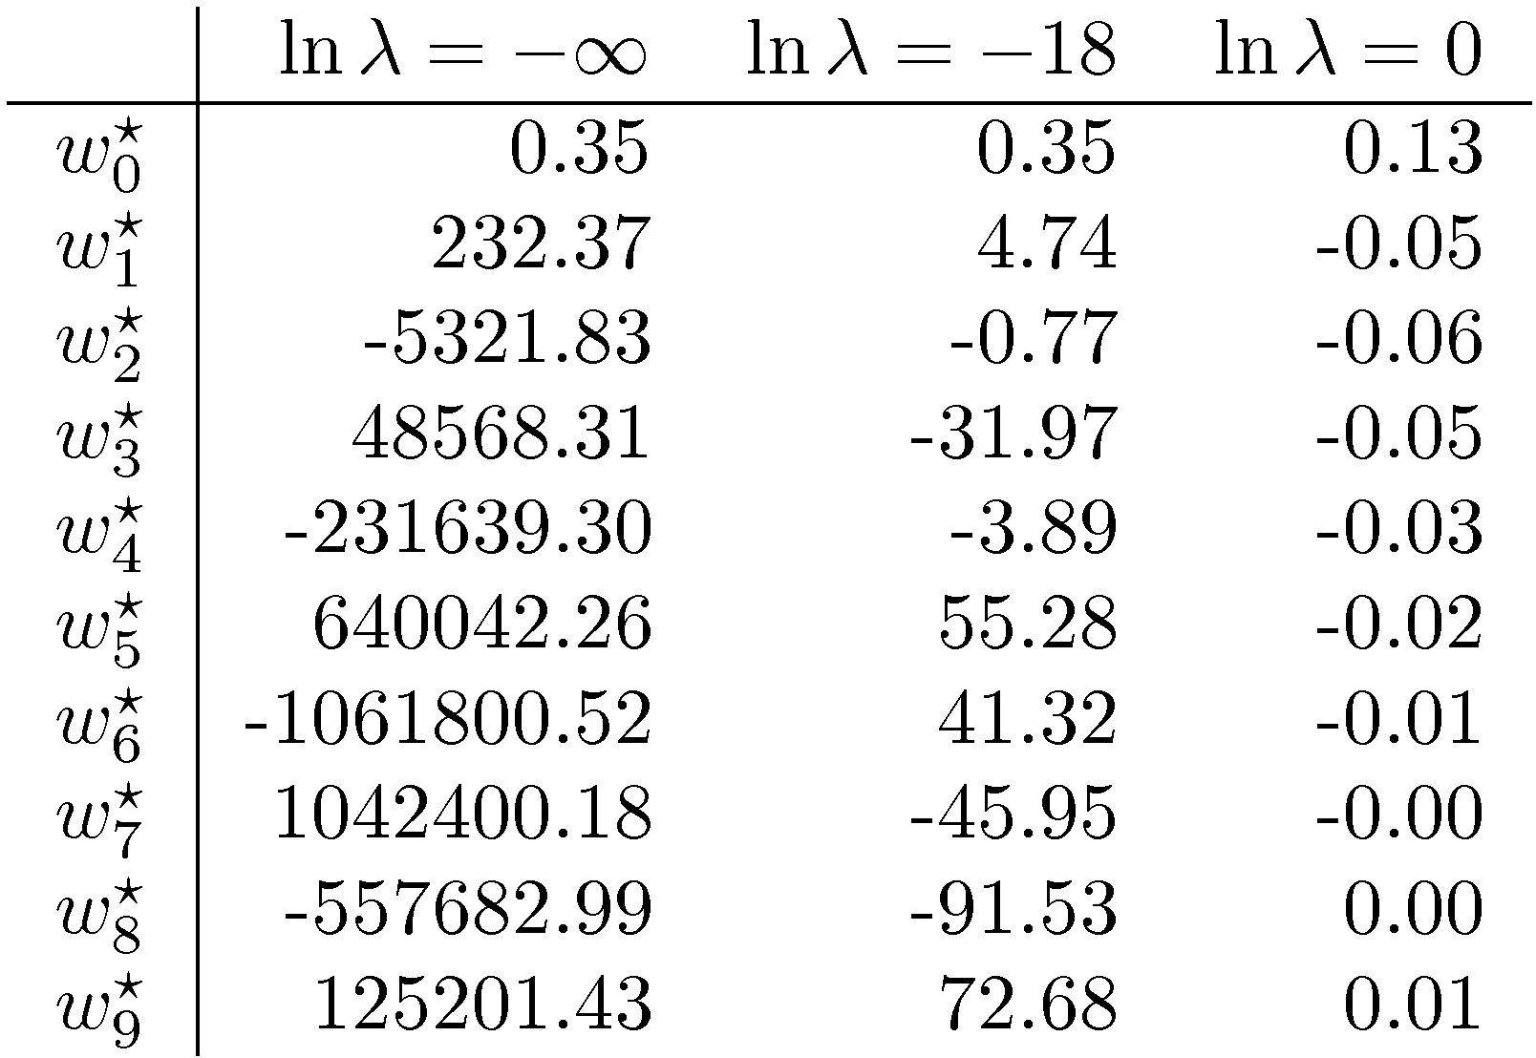
Polynomial Coefficients
none
exp(18)
huge

Slide 35
Summary
Simplest regression algorithm
Very fast
Good at numerical data with lots of features
Output from numerical continuous range
Linear hypothesis
Uses gradient descent

Slide 36
Logistic Regression

Slide 37
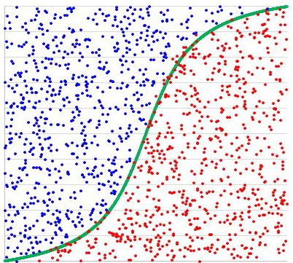
Logistic Regression
Output is a category
A classification algorithm that may have only two categories on the output, so it’s binary classification

Slide 38

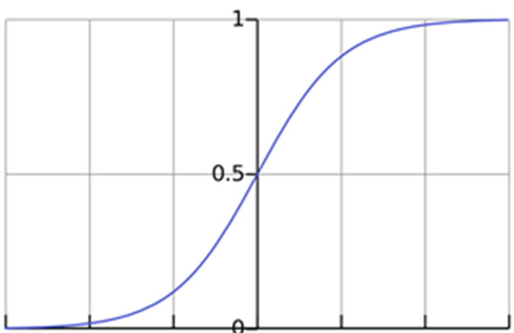
Sigmoid/Logistic Function
Estimated probability that Y = 1 on input X

Slide 39
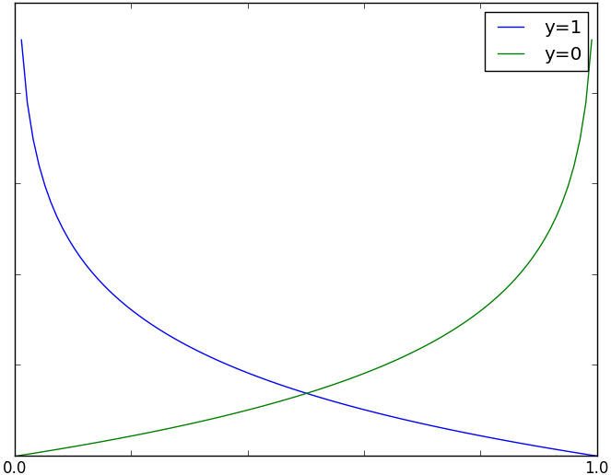
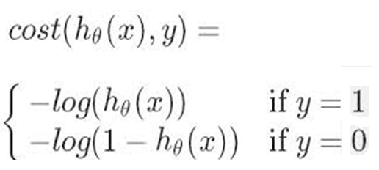
Loss function
Cost for a single training data example

Slide 40

Complete loss function
1. Uses the principle of maximum likelihood estimation.
2. We minimize it same way as with Linear Regression

Slide 41
Summary
Classification algorithm
Output is the binary value, either 1 or 0
Relatively small number of predictors
Uses logistics function for hypothesis
Has the cost function that is convex
Uses gradient descent for correcting the mistake

